Slide 1
Mockups
Admin

Slide 2
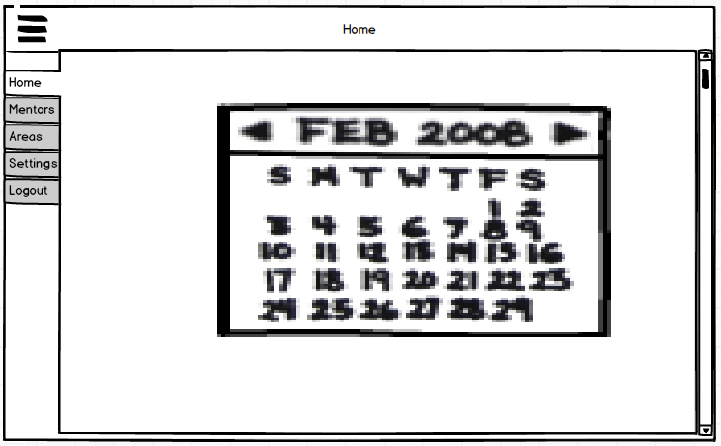
Home

Slide 3
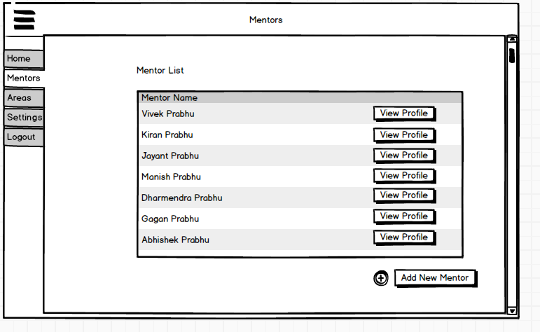
Mentors

Slide 4
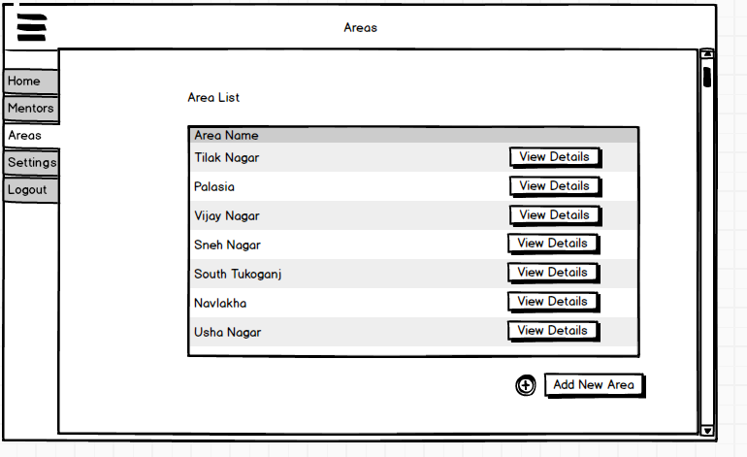
Areas

Slide 5
Mockups
Mentor

Slide 6
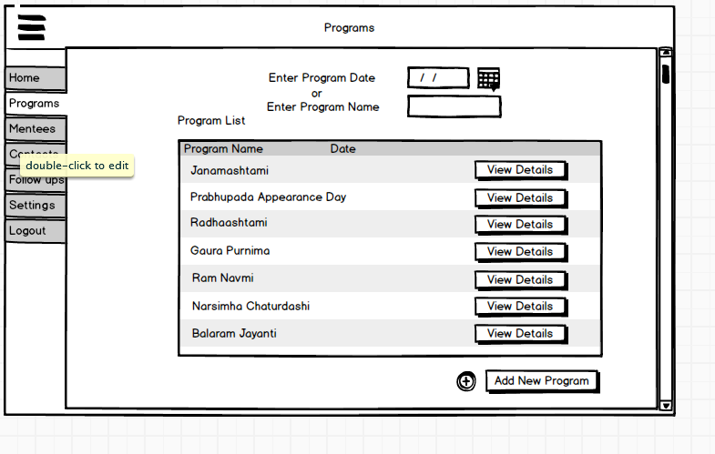
Programs

Slide 7
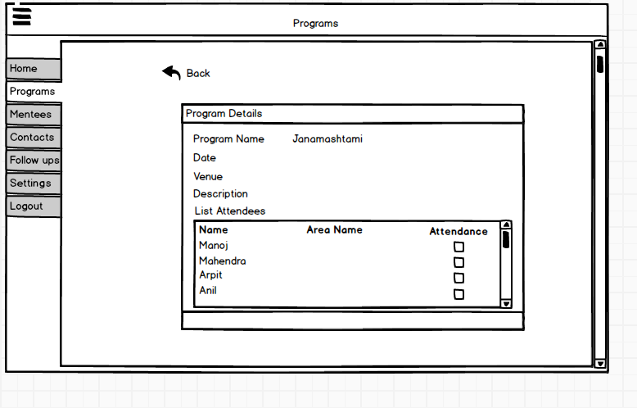
Program Details

Slide 8
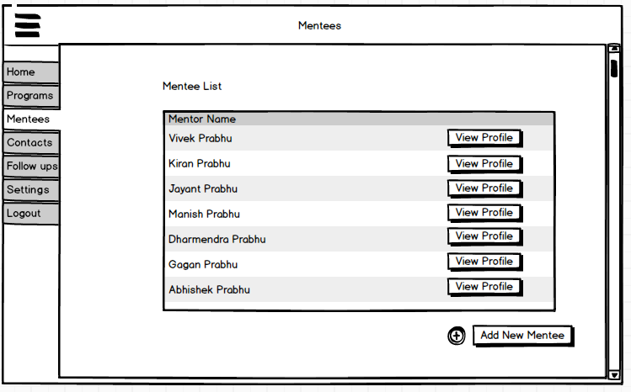
Mentees

Slide 9
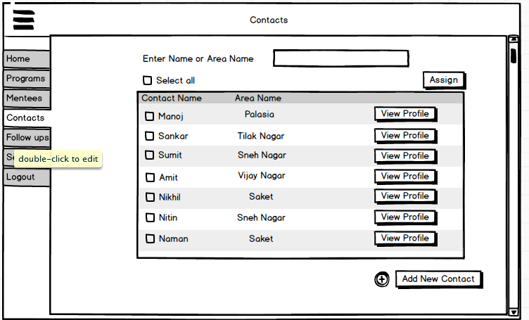
Contacts

Slide 10
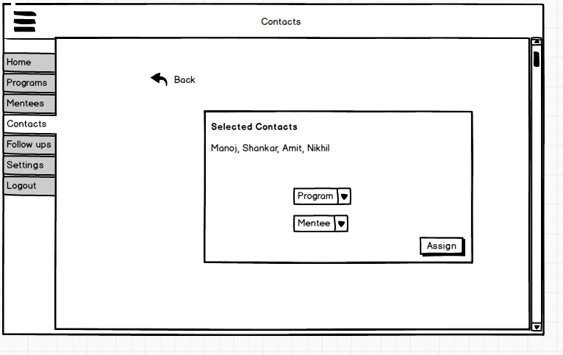
Contact Assignment

Slide 11
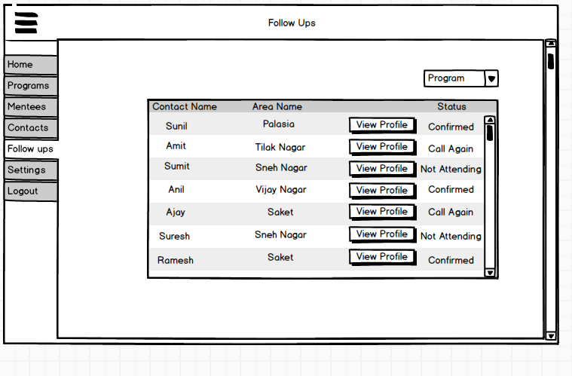
Follow Up

Slide 12
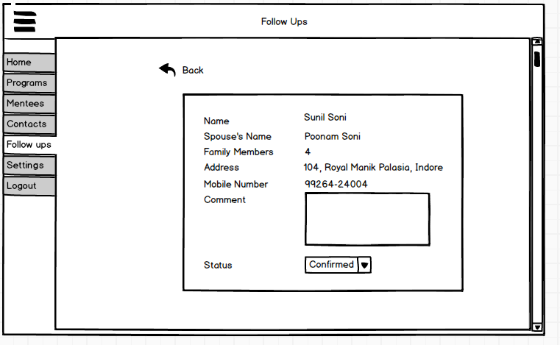
Follow Up Profile Page

Slide 13
Mockups
Mentee

Slide 14
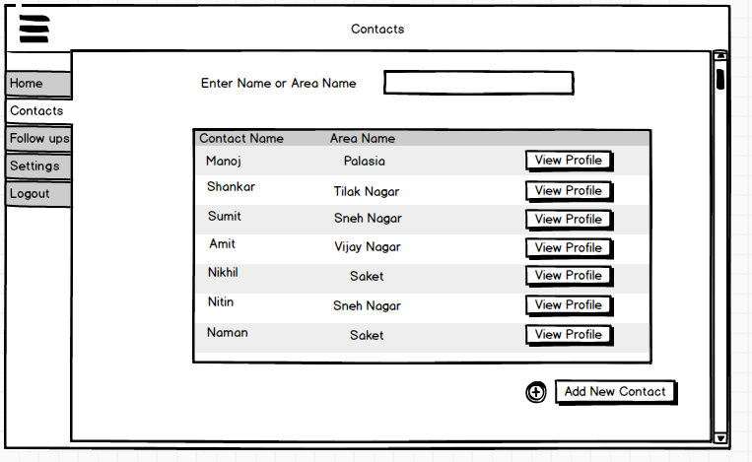
Contacts

Slide 15
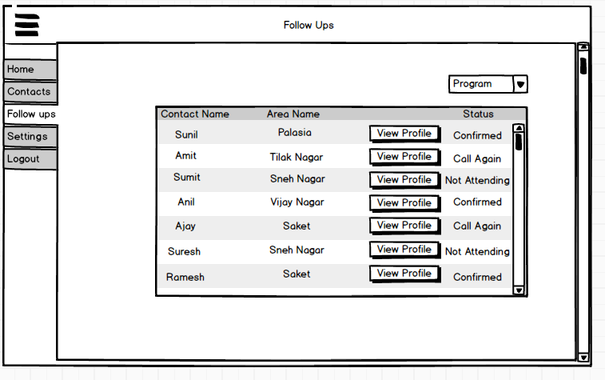
Follow Up

Slide 16
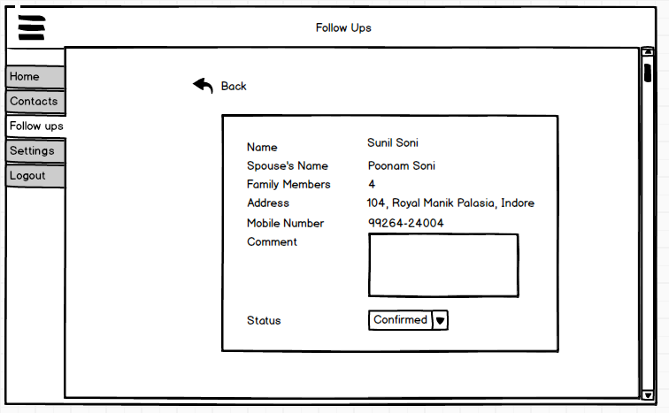
Contact Profile

